Slide 1
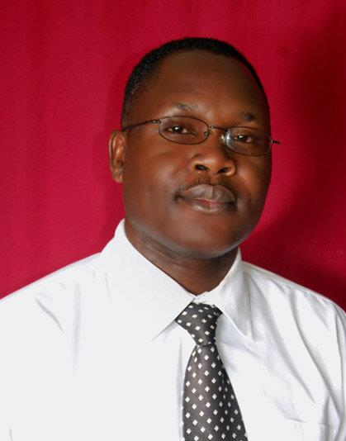
What threats do youths face on the internet today?
AYUB
Kalema – Golooba
Agkalema[AT]gmail.com
www.kalsworld.com
IM: agkalema
Notes:
If I asked you to name some of the threats youths face while using the internet, what would be your response?

Slide 2
Kidnap
Stereotypes
Propaganda
Pornography
Identity Theft
Blackmail
Anxiety
Cyber bullying
Communication
Theft
Loss of Privacy
Scams
Loss of Esteem
Radicalisation
Loneliness
Relationships
Notes:
Socialise
Communicate

Slide 3
“It’s not my business”
Blamed
Lectured
Rules & Regulations
Denial
Classic Response?
Blocked
Resigned
Expelled
Notes:
Have all the interventions worked? May be its time we went back to the drawing board
- Branded them as wiered spoiled brats

Slide 4
What if we Chose?
Protect
Inform
Condemning
Mentor, Coach, Counsel
On the Sidelines
Expelling
Take Action
Engage
Castigating Change Agents
Educate Ourselves
Notes:
What if we chose that rather than….
Rather than sitting on the sidelines minding our own business, what if we took action, got involved, got engaged in addressing the challenges that the youth we teach face in their day to day l

Slide 5
World Wide Wilderness?
Notes:
May be we can equip them with the skills to navigate the World Wide Wilderness

